Slide 1
Loading and Rendering a Pyramid
Advanced Game Engine Creation

Slide 2
Vertices
OpenGL uses the right hand coordinate system
Every vertex must have a 3D position, however we can specify additional properties
Colour
Texture coordinates
Normal (for lighting)
We decide what data to add to our vertices

Slide 3
Triangles
To construct an object, we create a triangle list that describes its shape
With a basic triangle list we can have lots of vertex duplications
Increases memory requirements
Increases processing by the GPU
We therefore need two lists
Vertices
Indices

Slide 4
Vertex Lists and Index Lists
Vertex list contains all the unique vertices in our model
Index list contains values that index into the vertex list
Each group of 3 vertices forms a triangle
The graphics card can store a list of all vertices in the scene and then use the index list to generate the triangles
Moves the duplication over to the index list

Slide 5
Simple data file for a square-bottomed pyramid
5
0.0 1.0 0.0
-0.5 0.0 0.5
0.5 0.0 0.5
0.5 0.0 -0.5
-0.5 0.0 -0.5
6
0 1 2
0 2 3
0 3 4
0 4 1
3 2 1
1 4 3
The file specifies:
number of vertices (corners)
the coordinates of each vertex
the number of triangles
the indices of the four vertices making up each face
Notice that we have specified each vertex only once
and used each in 3 or 4 different faces

Slide 6
Winding order
The order that we specify the vertices in each face is important
The winding order
The convention in OpenGL is that the vertices of the front face of each polygon are specified in counter-clockwise order (winding)
If we were inside the cube looking out, we would see the back faces of the polygons
Make sure all the outside faces of your model have CCW winding
1
2
0
3

Slide 7
Data structure for a vertex
// define in Commons.h
struct Vertex3D {
float x;
float y;
float z;
};

Slide 8
Header file for a pyramid
#ifndef _PYRAMID_H
#define _PYRAMID_H
#include <Windows.h> //Required for OpenGL on Windows
#include <gl/GL.h> //OpenGL
#include <gl/GLU.h> //OpenGL Utilities
#include "Commons.h"
class Pyramid
{
private:
Vertex3D * indexedVertices;
short * indices;
int numVertices;
int indexCount;
bool Load(char* path);
void DrawTriangle(short a, short b, short c);
public:
Pyramid(void);
~Pyramid(void);
void Draw(void);
void Update(void);
};
#endif

Slide 9
Pyramid.cpp constructors and destructors
#include "Pyramid.h"
#include <fstream>
#include <iostream>
using namespace::std;
Pyramid::Pyramid() {
Load("Pyramid.txt");
}
Pyramid::~Pyramid() {
delete indexedVertices;
delete indices;
}

Slide 10
Loading the pyramid
bool Pyramid::Load(char* path)
{
ifstream inFile;
inFile.open(path);
if (!inFile.good()) {
cerr << "Can't open model file " << path << endl;
return false;
}
inFile >> numVertices;
if (numVertices > 0) {
indexedVertices = new Vertex3D[numVertices];
for (int i = 0; i < numVertices; i++)
{
inFile >> indexedVertices[i].x;
inFile >> indexedVertices[i].y;
inFile >> indexedVertices[i].z;
}
}

Slide 11
Loading the pyramid (cont)
int numTriangles;
inFile >> numTriangles;
indexCount = numTriangles * 3;
if (indexCount > 0) {
indices = new short[indexCount];
for (int i = 0; i < indexCount; i++)
{
inFile >> indices[i];
}
}
inFile.close();
return true;
}

Slide 12
Drawing the pyramid
void Pyramid::Draw() {
for (int i = 0; i < indexCount; i += 3) {
DrawTriangle(indices[i], indices[i + 1], indices[i + 2]);
}
}
void Pyramid::DrawTriangle(short a, short b, short c) {
glBegin(GL_TRIANGLES);
glVertex3f(indexedVertices[a].x, indexedVertices[a].y, indexedVertices[a].z);
glVertex3f(indexedVertices[b].x, indexedVertices[b].y, indexedVertices[b].z);
glVertex3f(indexedVertices[c].x, indexedVertices[c].y, indexedVertices[c].z);
glEnd();
}

Slide 13
Constructing the pyramid
new private member variables in GameScreenLevel1.h
Pyramid * pyramid;
float rotation;
don't forget to #include the pyramid header file
construct the pyramid in GameScreenLevel1.cpp constructor
pyramid = new Pyramid();
rotation = 30.0f;

Slide 14
Updating and rendering the pyramid
in GameScreenLevel1::Update() method:
rotation += 0.1;
in GameScreenLevel1::Render() method
void GameScreenLevel1::Render()
{
//Clear the screen.
glClear(GL_COLOR_BUFFER_BIT | GL_DEPTH_BUFFER_BIT);
glLoadIdentity();
gluLookAt(0.0f, 0.0f, 10.0f,
0.0f, 0.0f, 0.0f,
0.0f, 1.0f, 0.0f);
glColor3f(0.5f, 0.5f, 0.5f);
glPushMatrix();
glRotatef(rotation, 1, 1, 1);
glScalef(5.0f, 5.0f, 5.0f);
pyramid->Draw();
glPopMatrix();
}

Slide 15
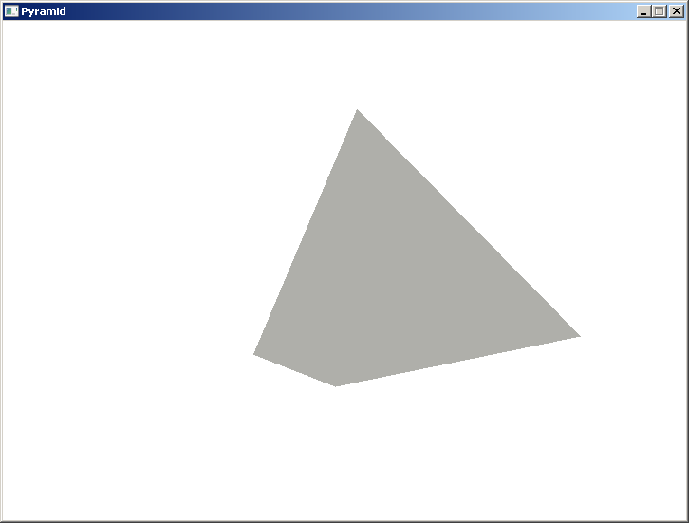
A pyramid!

Slide 16
Reading:
OpenGL programming Guide – Chapter 3 Viewing
http://glprogramming.com/red/chapter03.html
OpenGL 2.1 API documentation
https://www.opengl.org/sdk/docs/man2/
GLUT API documentation http://www.opengl.org/resources/libraries/glut/spec3/spec3.html
Chapter 11 – Geometric Object Rendering

